Slide 1

UiPath hackathon Covid travel advisor
Date: | 11.22.2021
Author: | Roboyo Bots Team
Version: | 1.0

Slide 2

Agenda
Lightning Talk
Covid trip advisor
1
Problem
International Travel during Covid
2
Solution
Covid Travel Advisor
3
UiPath Products
UiPath Studio, UiPath Apps, UiPath DataServices
4
Deployment
Deploy the app in your local environment

Slide 3

Problem
International Travel during Covid 19
International travel during Covid can be difficult as every country has different requirements, forms, tests, and quarantine periods. As an international company, Roboyo employees, often travel and find it difficult to navigate the covid requirements.
Potential Requirements include
Covid 19 Test predeparture
Entry restrictions based on vaccination status
Quarantine periods
Mask mandates
EU Health pass
Proof of vaccination status
Health screenings
Other possible restrictions
As every country has different requirements, it is easy to see how something could be forgotten or missed. This could result in delay or cancelled travel plans.

Slide 4

Solution
Covid Travel Advisor App
The Covid Trip Advisor App allows users to enter the origin and destinations along with the vaccination status of the traveler and outputs a convenient emailed checklist for all locations along the journey. Reducing the risk of delays or cancellations from missing or forgetting requirements.
View and organize all requirements for each designation
Summarizing requirements
Emailed checklist of all requirements for each destination

Slide 5
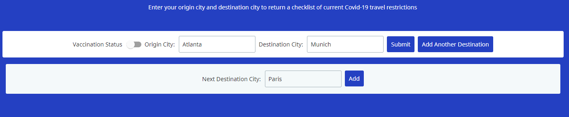
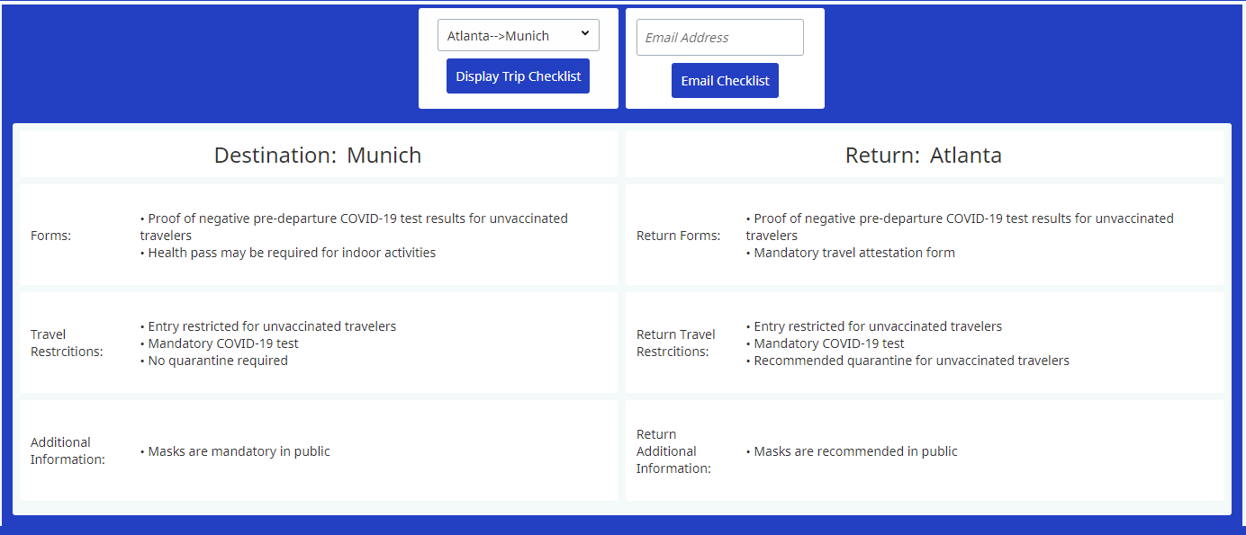
App Input/Output examples
APP Input
Vaccination Status
Origin City
Destination Cities
App Output
Checklist for each trip
Emailed Checklist for all locations

Slide 6
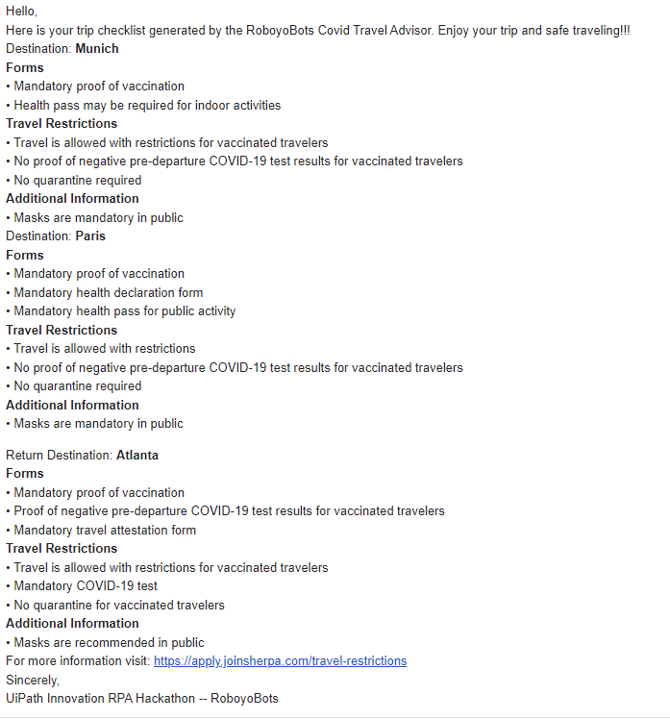
Sample Trip Checklist
Covid Travel Advisor App
Sample email generated by app
Origin: Atlanta
Destinations :
Munich
Paris
Return Location: Atlanta

Slide 7




Uipath Products
Uipath studio, data services, uipath apps
UiPath Studio was used to create process to scrape, manipulate, push data to UiPath Apps and Data Services
UiPath Apps was used to develop a user interface to allow easy interaction with the automated processes designed in studio.
UiPath Data Services was used to store data scraped from a webpage for each destination on the journey

Slide 8
Local Deployment
Follow steps below to run the app locally
Upload Process Packages to Orchestrator and create processes (.nupkg files)
Import to Schema to DataServices
TripSummarySchema_Dataservices.json
Create new UiPath App
Import file CovidTripAdvisor-UiPathHackathon2021.uiapp

Slide 9

Roboyo Bots Team
Thomas Mitchell | Senior Automation Engineer
Michael Gladstein | Solution Architect
Emiliano Lowe | Managed Operations Engineer
Joseph Hogan | Senior Consultant

